Slide 1
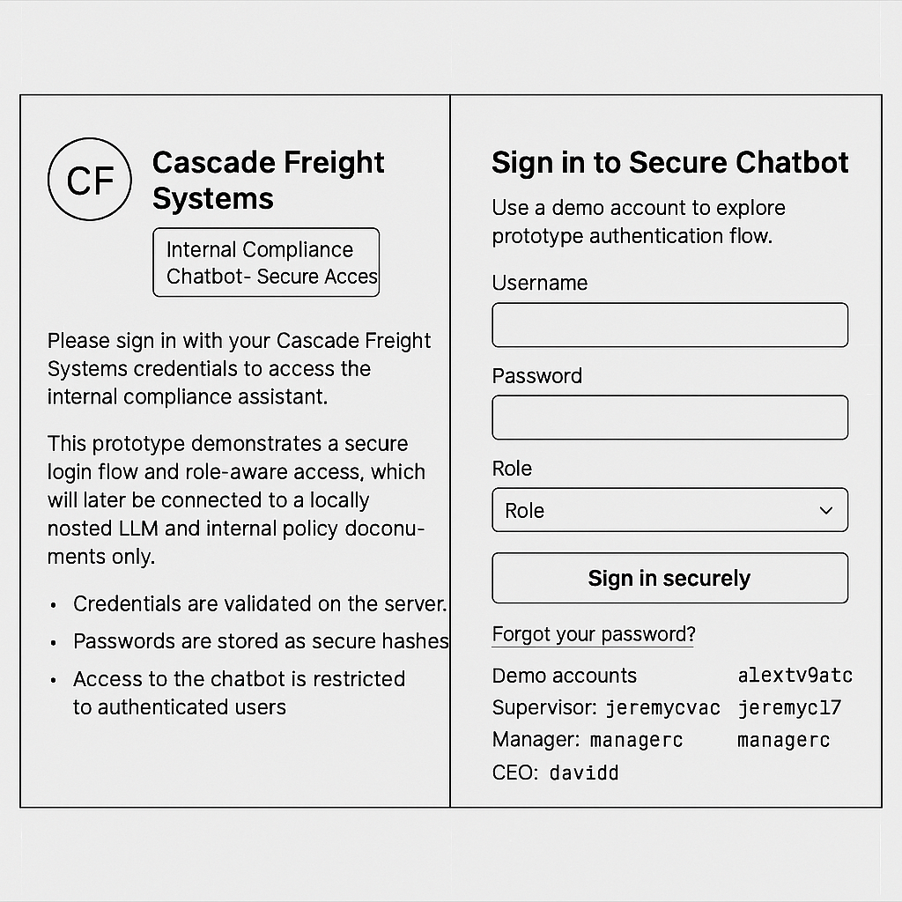
Cascade Freight Systems Chatbot
User Account Administration
User Story – 1.0 Login Page
As an employee, I want to log in using my credentials (username and password) so that I can securely access the chatbot features permitted by my role.
Development Tasks
Build login.html with username & password fields, login button, & forgot password link.
Implement backend authentication route to validate credentials.
Add session management (timeouts, secure logout).
Integrate multi-factor authentication.
Log all login attempts for audit purposes.

Slide 2
Cascade Freight Systems Chatbot
User Account Administration
User Story – 1.1 Role Assignment
As an employee, I want my role (dispatcher, driver, or support staff) to be assigned during account creation so that I only have access to the chatbot features relevant to my responsibilities.
Development Tasks
Implement role assignment during account creation (dispatcher, driver, support staff).
Enforce role‑based permissions in backend.
Store role data securely in database.

Slide 3
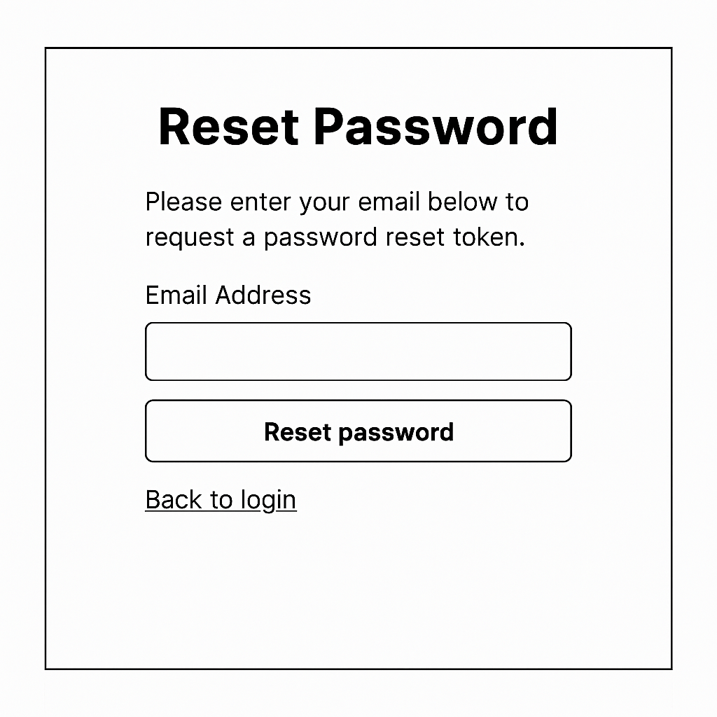
Cascade Freight Systems Chatbot
User Account Administration
User Story – 1.2 Forgot password Page
As an employee, I want to reset my password securely through internal verification so that I can regain access to the chatbot without compromising company data.
Development Tasks
Build forgot_password.html with fields for username/employee ID and reset instructions.
Implement backend route /forgot-password to handle reset requests.
Verify user identity through internal system checks (e.g., employee ID, secondary code).
Generate and send secure reset token/code to user.
Allow user to set a new password and update database securely.
Log all password reset requests and completions for audit purposes.

Slide 4
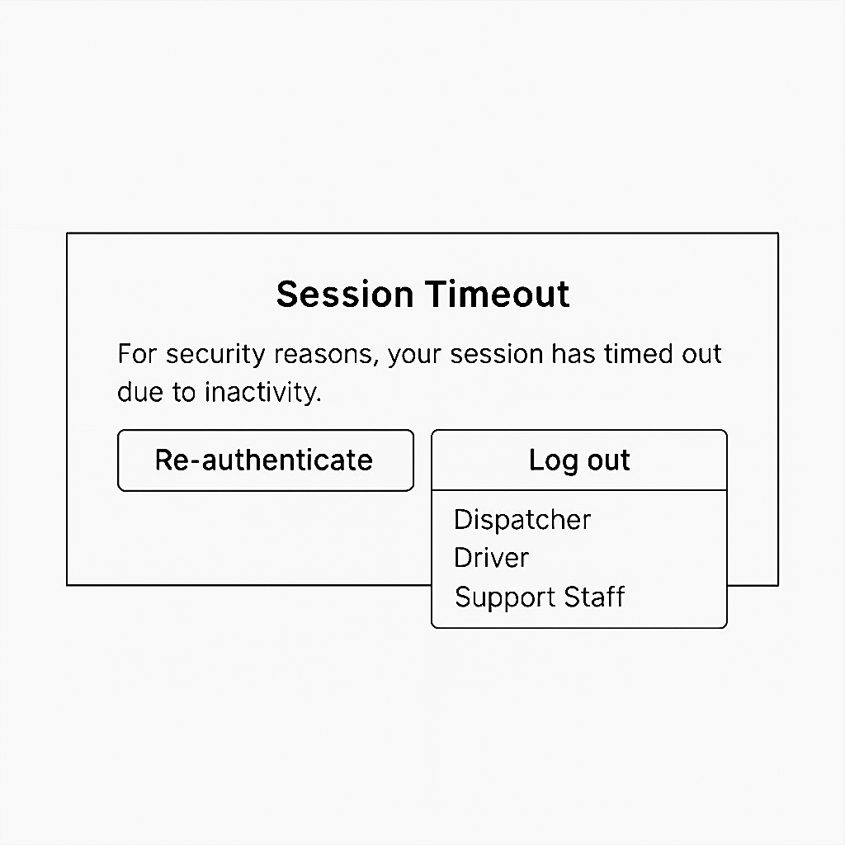
Cascade Freight Systems Chatbot
User Account Administration
User Story – 1.3 Session Management Page
As an employee, I want my session to automatically time out and log me out after inactivity so that my account remains secure from unauthorized access.
Development Tasks
Add automatic session timeout after inactivity.
Implement secure logout functionality.
Track session activity for audit logging.

Slide 5
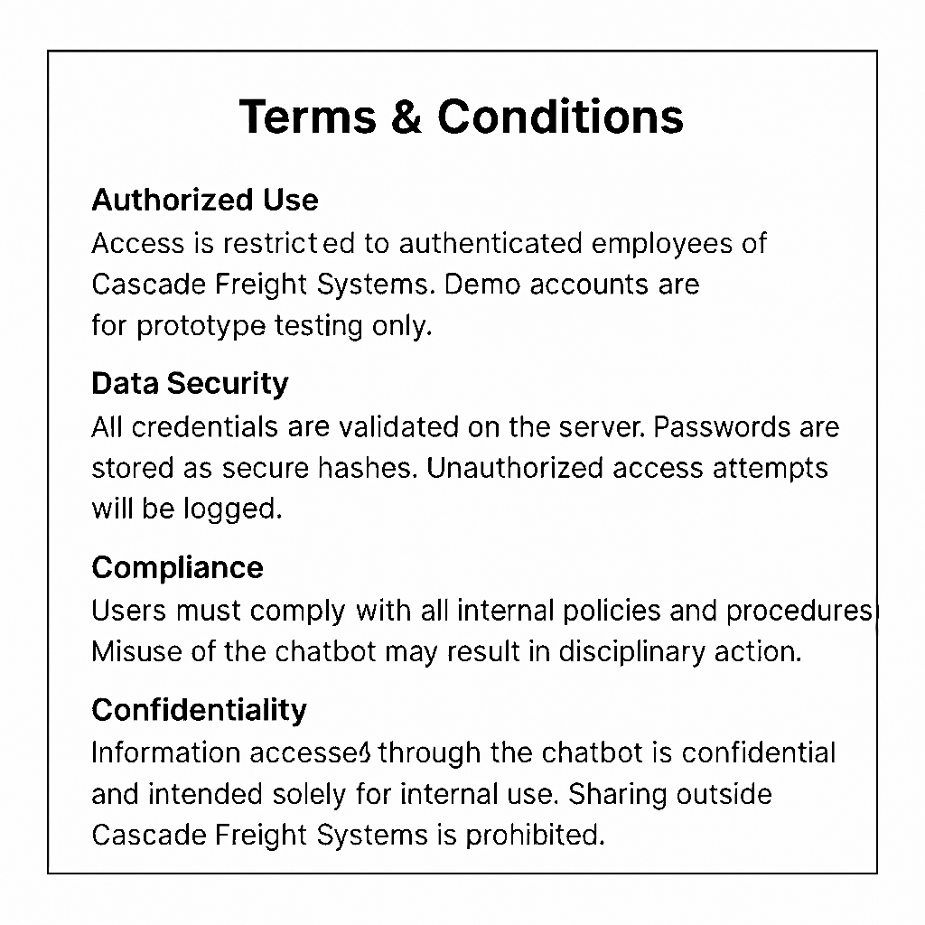
Cascade Freight Systems Chatbot
User Account Administration
User Story – 1.4 Terms & Conditions Page
As an employee, I want to review and accept the company’s Terms & Conditions before using the chatbot so that I understand and agree to the internal use policies.
Development Tasks
Display Terms & Conditions on login page.
Require user acceptance before granting access.
Log acceptance for compliance records.

Slide 6
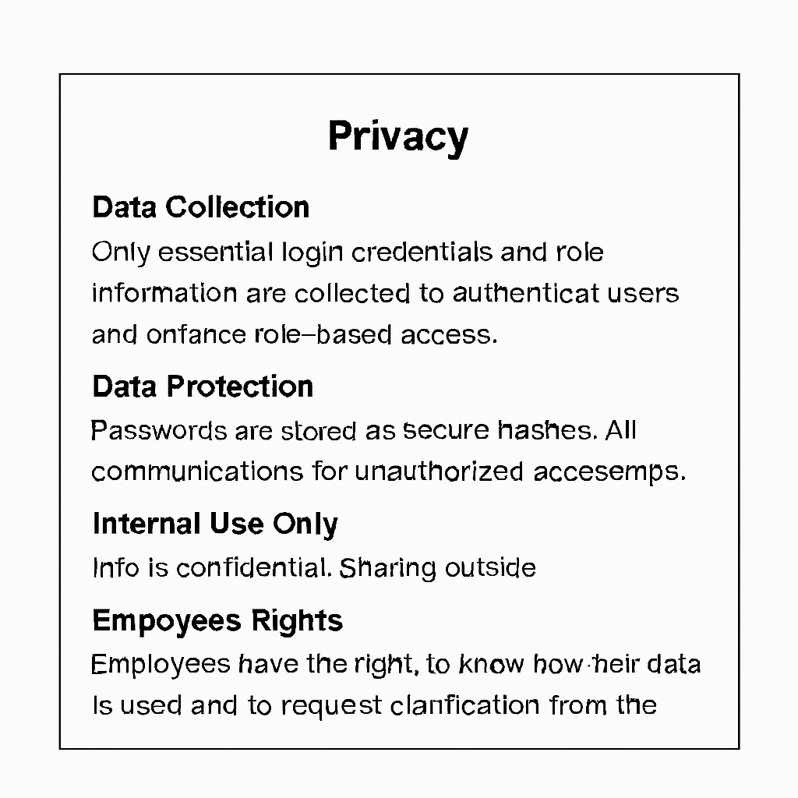
Cascade Freight Systems Chatbot
User Account Administration
User Story – 1.5 Privacy Page
As an employee, I want to see a clear Privacy Notice on the login page so that I know how my personal and work data is protected by the company.
Development Tasks
Show Privacy Notice on entry/login page.
Ensure clear, plain language about data protection.
Maintain version history of notices for audits.

Slide 7
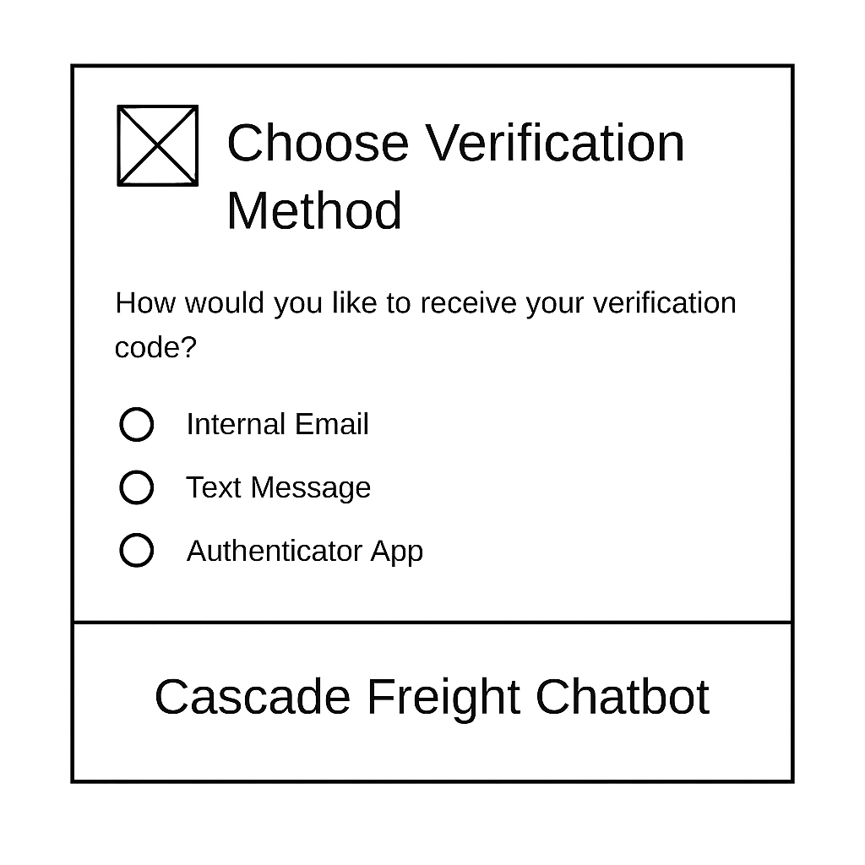
Cascade Freight Systems Chatbot
User Account Administration
User Story – 1.6 Multi-Factor Authentication Page
As an employee, I want to complete a second verification step (such as entering a code from the internal system) so that my login process is more secure and prevents unauthorized access.
Development Tasks
Add secondary verification step (internal code/token).
Integrate MFA with login workflow.
Log MFA attempts for audit and security monitoring.

